Slide 1

Testosterone, anastrozole and venous thrombosis
Rebecca Glaser, M.D.
22.05.2017

Slide 2
Background
Testosterone, anastrozole and venous thrombosis

Slide 3
FDA warning
[06/19/2014] The U.S. Food and Drug Administration (FDA) is requiring manufacturers to include a general warning in the drug labeling of all approved testosterone products about the risk of blood clots in the veins.
  Postmarket reports of venous blood clots unrelated to polycythemia
  Morgentaler, A., Miner, M. M., Caliber, M., Guay, A. T., Khera, M., and Traish, A. M. 2015.
  Testosterone therapy and cardiovascular risk: advances and controversies. Mayo Clinic Proceedings 90, 2, 224-251.
Notes:
www.fda.gov/Drugs/DrugSafety/ucm401746.htm
Vigen/Ho VA study (filled a Rx), Finkle (filled Rx vs. viagra rx, health insurance data base, insurance codes)
Vigen Unvalidate statistical methodology to reverse raw data, Gross errors
Morgentaler, A., Miner, M. M., Caliber, M., Guay, A. T., Khera, M., and Traish, A. M. 2015. Testosterone therapy and cardiovascular risk: advances and controversies. Mayo Clinic Proceedings 90, 2, 224-251.

Slide 4
Hormones and thrombosis
Physiological testosterone (T) replacement does not adversely affect blood coagulation status
  Pro-thrombotic effect of OCP, synthetic estrogens (Ethinyl estradiol, CEE), synthetic progestins (oral, SC) and possibly high levels of E2
Notes:
Smith, A. M., English, K. M., Malkin, C. J., Jones, R. D., Jones, T. H., and Channer, K. S. 2005. Testosterone does not adversely affect fibrinogen or tissue plasminogen activator (tPA) and plasminogen activator inhibitor-1 (PAI-1) levels in 46 men with chronic stable angina. European journal of endocrinology. 152, 2, 285-291.
Kim, H. C., Kemmann, E., Shelden, R. M., and Saidi, P. 1981. Response of blood coagulation parameters to elevated endogenous 17β-estradiol levels induced by human menopausal gonadotropins. American journal of obstetrics and gynecology. 140, 7, 807-810.
Toorians, A. W. F. T., Thomassen, M. C. L. G. D., Zweegman, S., Magdeleyns, E. J. P., Tans, G., Gooren, L. J. G., and Rosing, J. 2003. Venous thrombosis and changes of hemostatic variables during cross-sex hormone treatment in transsexual people. The Journal of Clinical Endocrinology & Metabolism. 88, 12, 5723-5729.
Tchaikovski, S. N. and Rosing, J. 2010. Mechanisms of estrogen-induced venous thromboembolism. Thrombosis research. 126, 1, 5-11. NON oral sustained levels
Canonico, M., Oger, E., Plu-Bureau, G., Conard, J., Meyer, G., Lévesque, H., Trillot, N., Barrellier, M.-T., Wahl, D., and Emmerich, J. 2007. Hormone therapy and venous thromboembolism among postmenopausal women. Circulation. 115, 7, 840-845.

Slide 5
Excess estrogen in the aging male
Increased aromatase activity
Increased fat mass, abdominal obesity
Symptoms
  Development of breast tissue, gynecomastia
  Fluid retention
  Weight gain
  Anxiety, emotional disturbances
  Erectile dysfunction
Notes:
Traish, A. M., Goldstein, I., and Kim, N. N. 2007. Testosterone and erectile function: from basic research to a new clinical paradigm for managing men with androgen insufficiency and erectile dysfunction. European urology. 52, 1, 54-70.
Mancini, A. N. T. O. N. I. O., Milardi, D. O. M. E. N. I. C. O., Bianchi, A., Summaria, V. I. N. C. E. N. Z. O., and De Marinis, L. A. U. R. A. 2005. Increased estradiol levels in venous occlusive disorder: a possible functional mechanism of venous leakage. International journal of impotence research. 17, 3, 239-242.

Slide 6
High estrogen + low testosterone
Increased risk of stroke
Progression carotid artery intima thickening
Coronary arteriosclerosis, MI
Lower extremity peripheral artery disease
Chronic inflammation
Insulin resistance
BPH
Prostate cancer
Notes:
Abbott, R. D., Launer, L. J., Rodriguez, B. L., Ross, G. W., Wilson, P. W. F., Masaki, K. H., Strozyk, D., Curb, J. D., Yano, K., and Popper, J. S. 2007. Serum estradiol and risk of stroke in elderly men. Neurology. 68, 8, 563-568.
Root-Bernstein, R., Podufaly, A., and Dillon, P. F. 2014. Estradiol binds to insulin and insulin receptor decreasing insulin binding in vitro. Frontiers in endocrinology. 5, 118.
Faloon, W. 2008. Dangers of Excess Estrogen In the Aging Male. Life Extension Magazine. 1.
Tivesten A, Hulthe J, Wallenfeldt K, et al. Circulating estradiol is an independent predictor of progression of carotid artery
intima-media thickness in middle-aged men. J Clin Endocrinol Metab. 2006 Nov;91(11):4433-7.
Mohamad MJ, Mohammad MA, Karayyem M, Hairi A, Hader AA. Serum levels of sex hormones in men with acute myocardial
infarction. Neuro Endocrinol Lett. 2007 Apr;28(2):182-6.
Vermeulen A, Kaufman JM, Goemaere S, van Pottelberg, I. Estradiol in elderly men. Aging Male. 2002 Jun;5(2):98-102.
Tivesten A, Mellstrom D, Jutberger H, et al. Low serum testosterone and high serum estradiol associate with lower extremity
peripheral arterial disease in elderly men. The MrOS Study in Sweden. J Am Coll Cardiol. 2007 Sep 11;50(11):1070-6.
Tengstrand B, Carlstrom K, Fellander-Tsai L, Hafstrom I. Abnormal levels of serum dehydroepiandrosterone, estrone, and
estradiol in men with rheumatoid arthritis: high correlation between serum estradiol and current degree of inflammation. J
Rheumatol. 2003 Nov;30(11):2338-43.
Stork S, Bots ML, Grobbee DE, van der Schouw YT. Endogenous sex hormones and C-reactive protein in healthy
postmenopausal women. J Intern Med. 2008 Mar 12.
Tripathi Y, Hegde BM. Serum estradiol and testosterone levels following acute myocardial infarction in men. Indian J Physiol
Pharmacol. 1998 Apr;42(2):291-4.
Singh PB, Matanhelia SS, Martin FL. A potential paradox in prostate adenocarcinoma progression: oestrogen as the
initiating driver. Eur J Cancer. 2008 May;44(7):928-36.
Ellem SJ, Risbridger GP. Aromatase and prostate cancer. Minerva Endocrinol. 2006 Mar;31(1):1-12.
Cavalieri E, Rogan E. Catechol quinones of estrogens in the initiation of breast, prostate, and other human cancers: keynote
lecture. Ann NY Acad Sci. 2006 Nov;1089:286-301.
Bosland MC. Sex steroids and prostate carcinogenesis: integrated, multifactorial working hypothesis. Ann NY Acad Sci.
2006 Nov;1089:168-76.
Ho CK, Nanda J, Chapman KE, Habib FK. Oestrogen and benign prostatic hyperplasia: effects on stromal cell proliferation
and local formation from androgen. J Endocrinol. 2008 Jun;197(3):483-91.

Slide 7
Subcutaneous T implants
Bypass the liver, no first pass effect
Do not adversely affect clotting factors
  Increase erythrocyte production, secondary erythrocytosis
  Renal erythropoietin vs. other
  Does elevated blood count from a non-pathologic cause increase the risk of thrombosis? Is elevated Hct causal?
  High altitude-no
  TRT-unknown
Notes:
Toorians, A. W. F. T., Thomassen, M. C. L. G. D., Zweegman, S., Magdeleyns, E. J. P., Tans, G., Gooren, L. J. G., and Rosing, J. 2003. Venous thrombosis and changes of hemostatic variables during cross-sex hormone treatment in transsexual people. The Journal of Clinical Endocrinology & Metabolism. 88, 12, 5723-5729.
Buckler, H. M., McElhone, K., Durrington, P. N., Mackness, M. I., Ludlam, C. A., and Wu, F. C. W. 1998. The effects of low‐dose testosterone treatment on lipid metabolism, clotting factors and ultrasonographic ovarian morphology in women. Clinical endocrinology. 49, 2, 173-178. DOI=10.1046/j.1365-2265.1998.00525.x.
Smith, A. M., English, K. M., Malkin, C. J., Jones, R. D., Jones, T. H., and Channer, K. S. 2005. Testosterone does not adversely affect fibrinogen or tissue plasminogen activator (tPA) and plasminogen activator inhibitor-1 (PAI-1) levels in 46 men with chronic stable angina. European journal of endocrinology. 152, 2, 285-291
Jones, S. D., Dukovac, T., Sangkum, P., Yafi, F. A., and Hellstrom, W. J. G. 2015. Erythrocytosis and Polycythemia Secondary to Testosterone Replacement Therapy in the Aging Male. Sexual Medicine Reviews. 3, 2, 101-112. DOI=10.1002/smrj.43.
Schreijer, A. J. M., Reitsma, P. H., and Cannegieter, S. C. 2010. High hematocrit as a risk factor for venous thrombosis. Cause or innocent bystander.

Slide 8
Increased aromatase and thrombosis
T is aromatized to estradiol (E2)
Elevated estradiol is also associated with increased hematocrit in men
Elevated estrogen can induce a hyper-coagulable state
  Increase coagulation factors
  Decrease anti-thrombin III
Notes:
Paller, C. J., Shiels, M. S., Rohrmann, S., Menke, A., Rifai, N., Nelson, W. G., Platz, E. A., and Dobs, A. S. 2012. Association between sex steroid hormones and hematocrit in a nationally representative sample of men. Journal of andrology. 33, 6, 1332-1341. DOI=10.2164/jandrol.111.015651.
Kim, H. C., Kemmann, E., Shelden, R. M., and Saidi, P. 1981. Response of blood coagulation parameters to elevated endogenous 17β-estradiol levels induced by human menopausal gonadotropins. American journal of obstetrics and gynecology. 140, 7, 807-810.
Blakemore, J. and Naftolin, F. 2016. Aromatase: contributions to physiology and disease in women and men. Physiology. 31, 4, 258-269.

Slide 9
Testosterone, Thrombophilia, and Thrombosis
13 men, 1 woman diagnosed with thrombosis on TRT
Increased risk (hypercoagulable/prothrombotic state)
  Factor V Lieden, Factor VIII, PAI-I gene or other
E2 levels were elevated
‘When exogenous T is aromatized to E2, and E2-induced thrombophilia is superimposed on thrombophilia–hypofibrinolysis, thrombosis occurs’
  Testosterone therapy should be stopped
  Glueck, C. J., Richardson-Royer, C., Schultz, R., Burger, T., Labitue, F., Riaz, M. K., Padda, J., Bowe, D., Goldenberg, N., and Wang, P. 2014. Testosterone, thrombophilia, and thrombosis. Clinical and Applied Thrombosis/Hemostasis. 20, 1, 22-30
Notes:
Glueck, C. J., Richardson-Royer, C., Schultz, R., Burger, T., Labitue, F., Riaz, M. K., Padda, J., Bowe, D., Goldenberg, N., and Wang, P. 2014. Testosterone, thrombophilia, and thrombosis. Clinical and Applied Thrombosis/Hemostasis. 20, 1, 22-30.

Slide 10
Methods
Testosterone, anastrozole and venous thrombosis

Slide 11
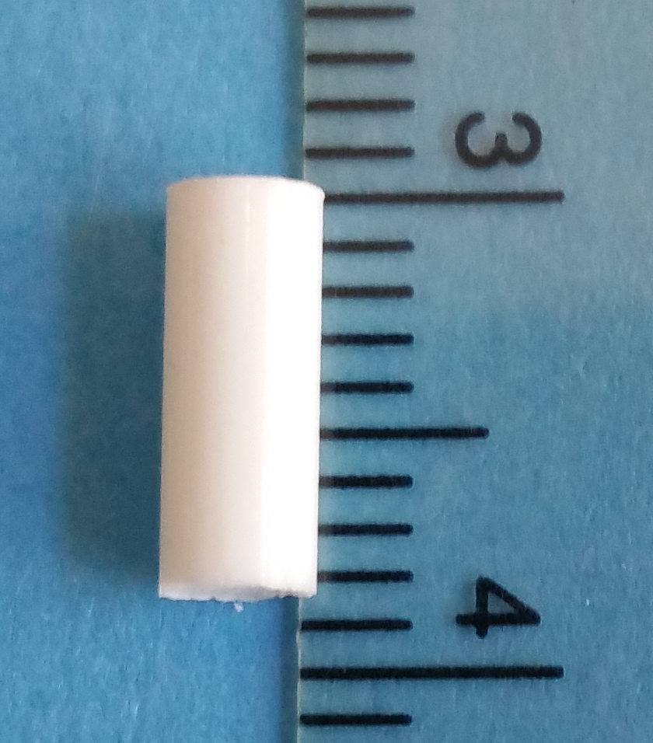
March 2013-2017
344 male patients
Prospective study
Cardiac and prostate events
SC T or T + Anastrozole (A) implants
  Aromatase inhibitor prescribed to prevent excess aromatization to E2

Slide 12
Laboratory Assessment
T and E2 levels week 4
T and E2 levels ‘end’ when symptoms returned (prior to re-implantation)
Hemoglobin, hematocrit

Slide 13
Patient demographics
Mean age at initial insert was 52.9 + 9.8 y
Mean age at analysis was 57.7 + 10.5 y
Mean baseline T 299.35 + 110.02 ng/dl
Mean length of therapy at analysis 4.8 + 3.1 y, range 0.17- 11.6 y
Height, weight, BMI

Slide 14
Results
Testosterone, anastrozole and venous thrombosis

Slide 15
Dosing (2013-17)
Mean T dose 1878 + 263 mg
339/344 (98.5%) of men treated with an AI, T + A implant
  <30% in 2010
Mean SC A dose was 14.8 + 3.9 mg with the majority of men receiving 16 mg A
  2 x T 120 mg + A 8 mg implant
Notes:
1 mg / d BCA pts.
Oral dose men 0.5 mg 2-3 times weekly

Slide 16
Levels on therapy
Mean T level at week 4 was 1235 + 313 ng/dl
  25% T > 1500 ng/dl
  65% T > 1100 ng/dl
  No ADE
Mean E2 at week 4 was 16.45 + 11.73 pg/ml
Mean T level when symptoms returned was 586 + 248 ng/dl
Mean E2 ‘end’ was 18.65 + 11.78 pg/ml

Slide 17
Erythrocyte count
Mean Hb on therapy was 16.3 + 1.33 g/dl
Mean Hct was 48.5 + 4.0
  Elevated Hct correlated with T and E2 levels
Donate blood for Hb > 18.5 or Hct > 55
  Offer to reduce T dose
Notes:
Hanafy, H. M. 2007. Testosterone therapy and obstructive sleep apnea: is there a real connection. The journal of sexual medicine. 4, 5, 1241-1246. DOI=10.1111/j.1743-6109.2007.00553.x.

Slide 18
Secondary erythrocytosis
27 men on study (donated blood)
Increased with higher T doses 2013-17
1/3 men with elevated rbc have/had a diagnosis of obstructive sleep apnea
  Secondary polycythemia (hypoxia)
Do not see an increase in sleep apnea in men on SC T + A therapy
Notes:
Wittert, G. 2014. The relationship between sleep disorders and testosterone in men. Asian journal of andrology. 16, 2, 262.
Hanafy, H. M. 2007. Testosterone therapy and obstructive sleep apnea: is there a real connection. The journal of sexual medicine. 4, 5, 1241-1246. DOI=10.1111/j.1743-6109.2007.00553.x.
Franklin, K. A. and Lindberg, E. 2015. Obstructive sleep apnea is a common disorder in the population—a review on the epidemiology of sleep apnea. Journal of thoracic disease. 7, 8, 1311-1322. 6% (4-18%) male
Bercea, R. M., Mihaescu, T., Cojocaru, C., and Bjorvatn, B. 2015. Fatigue and serum testosterone in obstructive sleep apnea patients. The clinical respiratory journal. 9, 3, 342-349. DOI=10.1111/crj.12150. Low T OSA

Slide 19
Results
No episodes of venous thrombosis or thromboembolic events in 344 men treated with T + A implants in over 1600 person-years of therapy
This compares favorably to an expected annual incidence of 149/100 000 (1.5/1000) for males age 55-59 y (57.7 y)
Silverstein, M. D., Heit, J. A., Mohr, D. N., Petterson, T. M., O’fallon, W. M., and Melton, L. J. 1998. Trends in the incidence of deep vein thrombosis and pulmonary embolism: a 25-year population-based study. Archives of internal medicine. 158, 6, 585-593.
Notes:
Silverstein, M. D., Heit, J. A., Mohr, D. N., Petterson, T. M., O’Fallon, W. M., and Melton, L. J. 1998. Trends in the incidence of deep vein thrombosis and pulmonary embolism: a 25-year population-based study. Archives of internal medicine. 158, 6, 585-593.
Nordström, M., Lindblad, B., Bergqvist, D., and Kjellström, T. 1992. A prospective study of the incidence of deep‐vein thrombosis within a defined urban population. Journal of internal medicine. 232, 2, 155-160. DOI=10.1111/j.1365-2796.1992.tb00565.x.

Slide 20
Discussion & Conclusion
Testosterone, anastrozole and venous thrombosis

Slide 21
Safety of TRT
T does not increase the risk of thrombosis or adversely affect clotting factors
T increases nitric oxide and inhibits platelet aggregation
Does elevate red blood count
Notes:
Campelo, A. E., Cutini, P. H., and Massheimer, V. L. 2012. Testosterone modulates platelet aggregation and endothelial cell growth through nitric oxide pathway. Journal of Endocrinology. 213, 1, 77-87.
Kelly, D. M. and Jones, T. H. 2013. Testosterone: a vascular hormone in health and disease. Journal of Endocrinology. 217, 3, R47-R71.
Smith, A. M., English, K. M., Malkin, C. J., Jones, R. D., Jones, T. H., and Channer, K. S. 2005. Testosterone does not adversely affect fibrinogen or tissue plasminogen activator (tPA) and plasminogen activator inhibitor-1 (PAI-1) levels in 46 men with chronic stable angina. European journal of endocrinology. 152, 2, 285-291
Toorians, A. W. F. T., Thomassen, M. C. L. G. D., Zweegman, S., Magdeleyns, E. J. P., Tans, G., Gooren, L. J. G., and Rosing, J. 2003. Venous thrombosis and changes of hemostatic variables during cross-sex hormone treatment in transsexual people. The Journal of Clinical Endocrinology & Metabolism. 88, 12, 5723-5729

Slide 22
Safety of TRT
Side effects of TRT (thrombophilia) may be due to aromatization and increased estradiol
Estrogen levels should be monitored
Aromatization takes place at the cellular level (intracrine, paracrine) and may not be reflected in serum levels
  Signs and symptoms estrogen excess
Notes:
Labrie, F., Bélanger, A., Cusan, L., Gomez, J.-L., and Candas, B. 1997. Marked decline in serum concentrations of adrenal C19 sex steroid precursors and conjugated androgen metabolites during aging. The Journal of Clinical Endocrinology & Metabolism. 82, 8, 2396-2402.
Vermeulen, A., Kaufman, J. M., Goemaere, S., and Van Pottelberg, I. 2002. Estradiol in elderly men. The Aging Male. 5, 2, 98-102.

Slide 23
Strengths
Single (real life) clinical practice
Prospective study
Compliance is documented
Not subject to errors and low quality data sources associated with data mining*
Patients and charts available
Treating physician collects the data
*Real-world data mining applications often deal with low-quality information sources where data collection inaccuracy, device limitations, data transmission and discretization errors, or man-made perturbations frequently result in imprecise or vague data.
Notes:
Vigen and Finkle (men who filled a first prescription) studies
Zhu, X. and Wu, X. 2006. Error awareness data mining. Granular Computing, 2006 IEEE International Conference on, 269-274.

Slide 24
Weakness/caution
Not a randomized trial
Small numbers, N = 344
< 5 years (4.8 y)
Results are applicable to SC implants
Results are applicable to T + AI

Slide 25
Conclusion
SC T + A implant therapy does not increase and may lower the occurrence of venous thrombotic events
Aromatase inhibitors play a role in prevention of side effects from T therapy
Monitor Hb and Hct
Address sleep issues in men with elevated Hct on TRT

Slide 26
Questions
Testosterone, anastrozole and venous thrombosis

