Slide 1

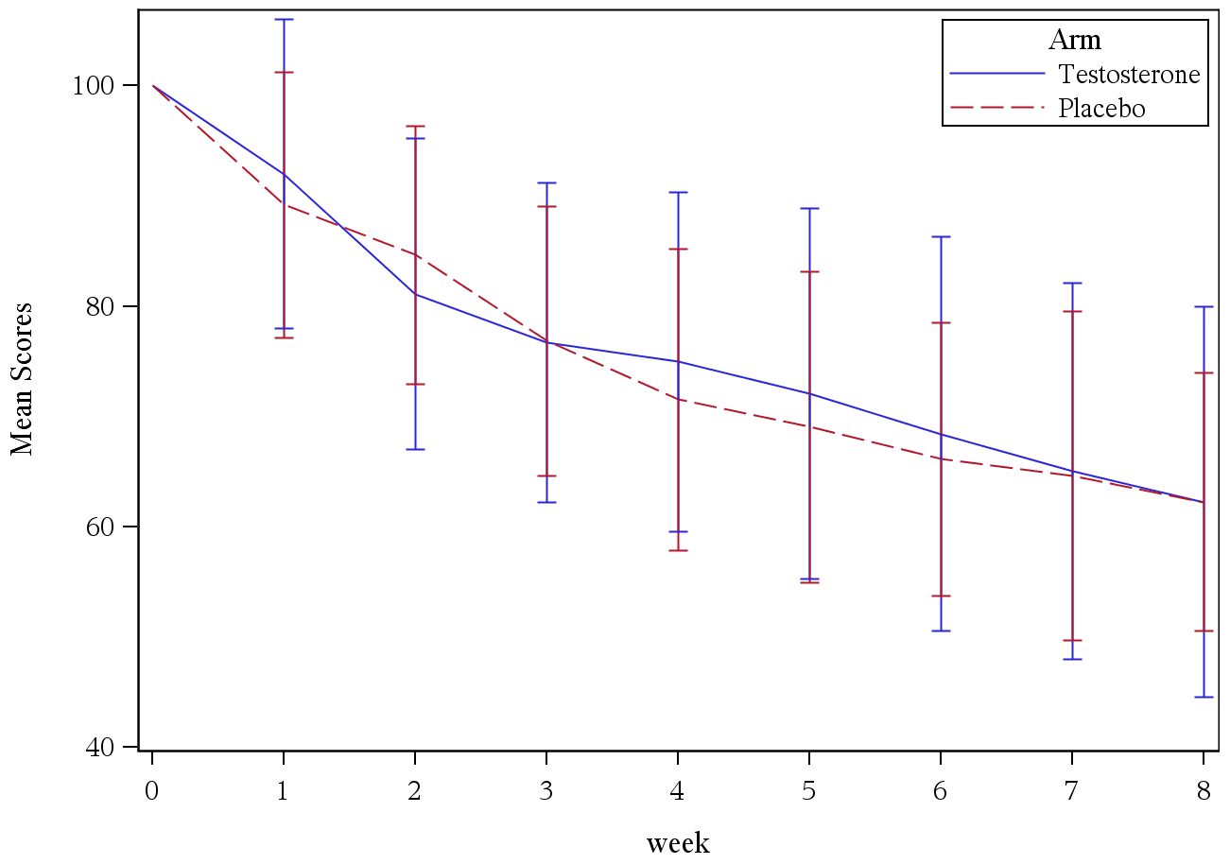
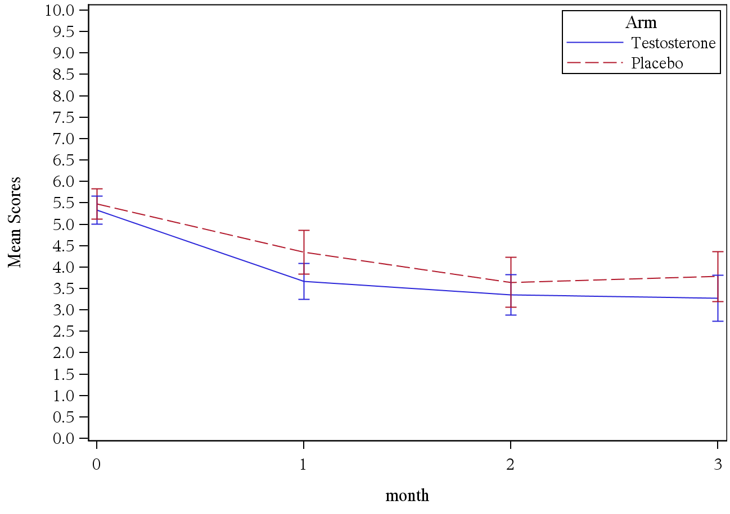
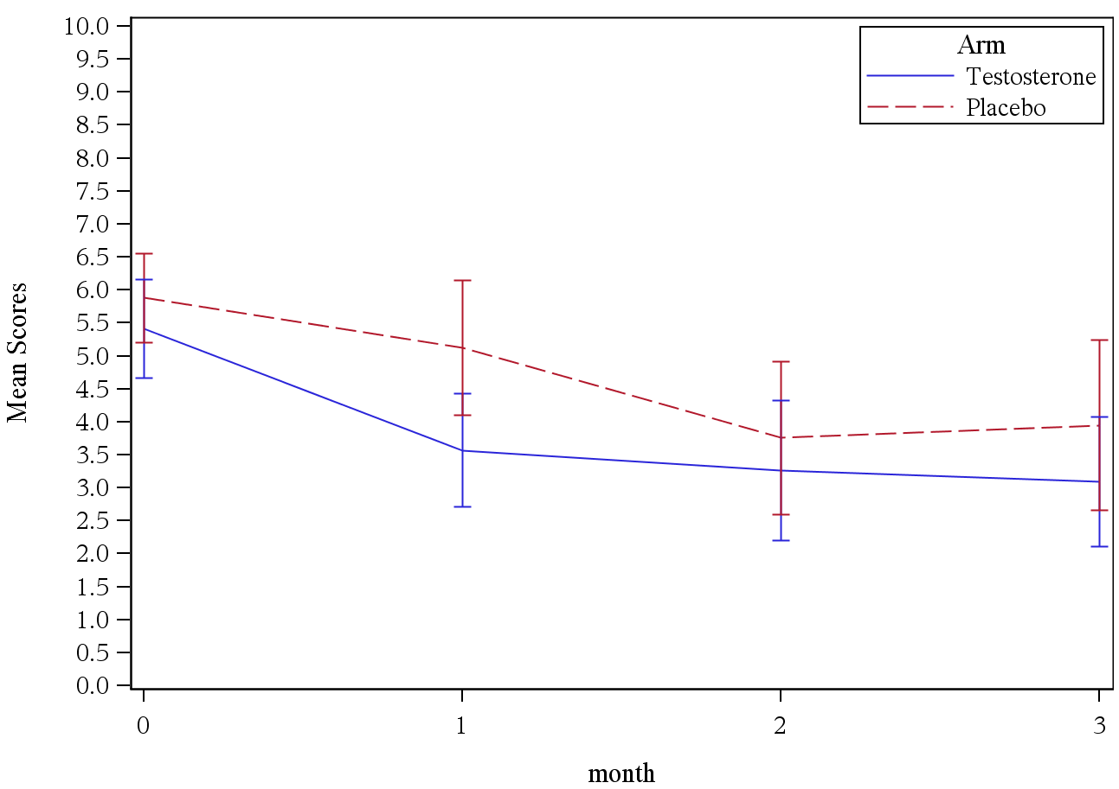
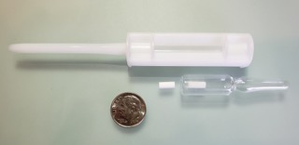
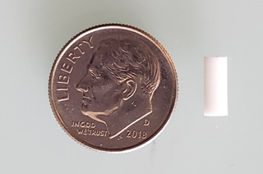
A randomized, double-blind, placebo-controlled trial of testosterone (T) for aromatase inhibitor-induced arthralgias (AIA) in postmenopausal women: Alliance A221102
Roberto A. Leon-Ferre¹, Jennifer Le-Rademacher¹, Shelby Terstriep², Rebecca Glaser³, Paul Novotny¹, Armando Giuliano⁴, M Sitki Copur⁵, Cheryl Jones⁶, Seth Page⁷, William Mitchell⁸, Stephen N Birrell⁹, and Charles L Loprinzi¹
¹Mayo Clinic, Rochester, MN, USA; ²Sanford Broadway Medical Center, Fargo, ND, USA; ³Wright State University, Dayton, OH, USA; ⁴Cedars-Sinai Medical Center, Los Angeles, CA, USA; ⁵Saint Francis Cancer
Treatment Center, Grand Island, NE, USA; ⁶Georgia Cancer Specialists PC, Macon, GA, USA; ⁷Cancer Center of Kansas-Wichita Medical Arts Tower, Wichita, KS, USA; ⁸Novant Health Presbyterian Medical Center, Charlotte, NC, USA; ⁹Havah Therapeutics Pty Ltd, Toorak Gardens, South Australia, Australia
Background & Objectives
Key eligibility criteria
Table 1: Baseline patient characteristics
Figure 4: Mean % change in baseline hot flash score
Results
  Aromatase inhibitors represent a major component of the treatment of patients with hormone receptor-positive breast cancer.
  Musculoskeletal symptoms, particularly joint pain and stiffness, can occur in up to 50% of women taking these agents.^{1,2} This may result in a quality of life detriment and in a decrease in treatment compliance.
  Nonpharmacological interventions such as exercise and acupuncture have been found to be effective in decreasing aromatase inhibitor-induced arthralgia (AIA), but are not feasible for all patients.^{3,4,5} Pharmacological intervention such as duloxetine have also been found to be effective.⁶
  A previously reported small phase II clinical trial of oral testosterone unedeconate appeared to improve AIA over placebo, with no significant androgenic effects.⁷ The current study was performed to confirm these findings.
  INCLUSION CRITERIA
  Women 18 years or older.
  Postmenopausal (either naturally or induced).
  Prior surgery for primary breast cancer that was estrogen (ER) and progesterone receptor (PR) positive (>25% or Allred score of ≥5 for both ).
  Experiencing moderate-to-severe arthralgias (rated ≥5 in a 10-point scale).
  Receiving anastrozole or letrozole for ≥21 days prior to registration, and plan to continue throughout the duration of the study.
  EXCLUSION CRITERIA
  Taking tamoxifen or exemestane.
  Residual or recurrent cancer.
  Co-moborbities including diabetes mellitus, glucose intolerance, coronary artery disease, venous thromboembolism.
  Receiving hormone replacement therapy.
  Concomitant chemotherapy or radiation therapy.
  No differences in study discontinuation between testosterone and placebo, with patients remaining on study an average of 22.5 wks (range 2.1 – 32.3 wks).
  Per the BPI-AIA questionnaire, no significant differences were seen between the two arms in the average pain or joint stiffness at 3 (Figure 3) or 6 months compared to baseline.
  Using repeated measures models, the BPI-AIA average pain score was significantly lower each month, but this was independent of treatment arm.
  Hot flash frequency and scores were not significantly different between arms (Figure 3).
  No significant differences on any of the items evaluated in the POMS or MENQOL questionnaires.
  No significant differences in toxicity at 3 or 6 months.
  In a subset analysis of the 51 evaluable pts enrolled on the study prior to the amendment, pts who were randomized to receive T+AI pellets reported more reduction in the BPI-AIA average pain scores during the first month (p=0.04) compared to placebo. There were no differences in the subsequent months.
  Patients on T+AI pellets reported significantly less nausea (p=0.02), fatigue (p=0.04), mood swings (p=0.03), hand/feet swelling (p<0.01), stress urinary incontinence (p=0.04), and changes in skin appearance, texture or tone (p<0.01) compared to patients on P pellets.
 | Testosterone (n=104) | Placebo (n=104) | P-value
Mean age, years | 60 | 60 | 0.97
Age group < 50 years 50-60 years > 60 years | 12% 43% 45% | 14% 39% 47% | 0.83
Prior therapy for AIA | 64% | 56% | 0.32
Mean BMI (SD) | 28 (4) | 27 (4) | 0.02
AI duration < 6 months 6-12 months > 12 months | 14% 25% 61% | 26% 23% 51% | 0.07
Baseline pain score, mean (SD) | 5.4 (1.7) | 5.5 (1.8) | 0.55
Baseline Hgb, mean (SD) | 13.8 (2.0) | 13.2 (1.0) | 0.02
p = 0.72
Methods
Figure 1: Consort diagram
Abbreviations: AI = aromatase inhibitor, AIA = aromatase inhibitor-induced arthralgia, Hgb = hemoglobin, SD = Standard deviation
This was a randomized placebo-controlled trial.
Patients were initially randomized to receive a subcutaneous pellet (Figure 1) containing testosterone (T) 120 mg + anastrozole (AI) 8 mg (T+AI pellet) or placebo (P pellet) at the end of the first week on study and at 3 months.
Due to slow accrual, the protocol was amended to change the route of delivery to topical T or P applied to the skin daily for 6 months.
Baseline and monthly questionnaires were administered, including: Modified Brief Pain Inventory for aromatase arthralgia (BPI-AIA), profile of mood states (POMS), the menopause specific quality of life questionnaire (MENQOL), a hot flash diary, the hot flash-related daily interference scale (HFRDIS), and a symptom experience questionnaire.
The primary endpoint was the intra-patient change in joint pain at 3 months, compared using a two-sample t-test
227 enrolled
Figure 3: BPI-AIA average scores over time (ITT)
Figure 4: BPI-AIA average scores over time (T+AI pellet)
Testosterone
114 enrolled
Placebo
113 enrolled
P=0.50
10 cancelled
9 cancelled
Conclusions
104 evaluable
104 evaluable
p = 0.50
p = 0.46
  Overall, testosterone did not improve AIA or menopausal symptoms compared to placebo.
  While there was significant improvement in AIA over the study period, testosterone did not facilitate this process.
  T+AI pellets were associated with improvement in short-term AIA and several menopausal symptoms compared to placebo, suggesting that SQ T + AI implants may be superior to transdermal T alone
25 T+AI Pellet
79 Topical T
26 P Pellet
79 Topical P
Figure 2: Pellets
References
  1. Crew et al, JCO 2007
  2. Henry et al, BCRT 2008
  3. Irwin et al, JCO 2015
  4. Crew et al, JCO 2010
  5. Hershman et al, AACR 2018
  6. Henry et al, JCO 2018
  7. Birrell et al, AACR 2009
For questions: leonferre.roberto@mayo.edu
© 2015 Mayo Foundation for Medical Education and Research

